Slide 1
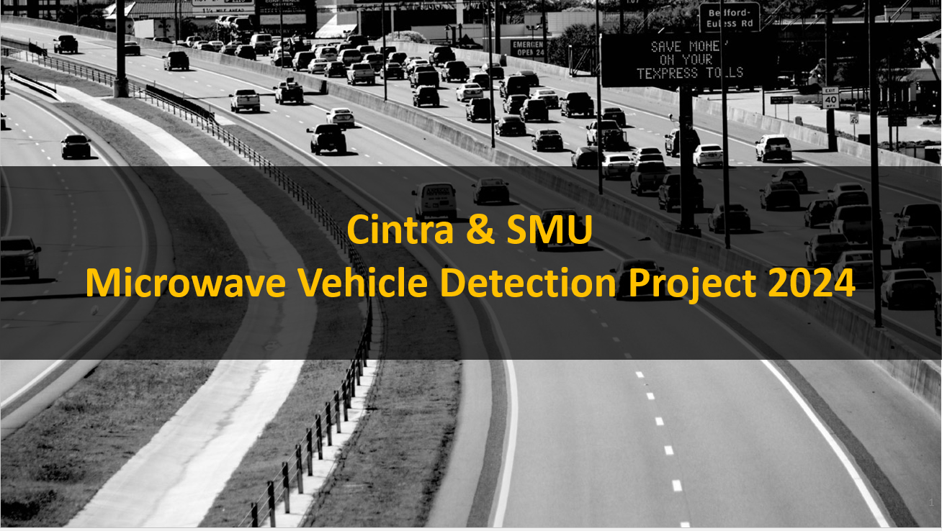


North Tarrant Express B
Segment 2 West Bound Project

Slide 2





Team Members Masters in Business Analytics
Ajay Namala
Mahendra Singh
Saranya Sudharsan
Bindiya Savanur
Aravind Vennu

Slide 3
Executive Summary
Key Business Insights derived from the project:
Maintenance is needed on MVDs for accurate data
Trends in the volume of MVD have been identified
Use of the Prediction Model for:
Data-Driven Decision Making - Increase Operational Efficiency
Revenue Optimization – Adjust the Toll Tariffs based on the predicted volume
Business Questions Answered
What are the daily traffic flow patterns?
How can toll adjustments be optimized for revenue based on traffic volume?
How accurate are the predictive models in estimating traffic volumes?

Slide 4
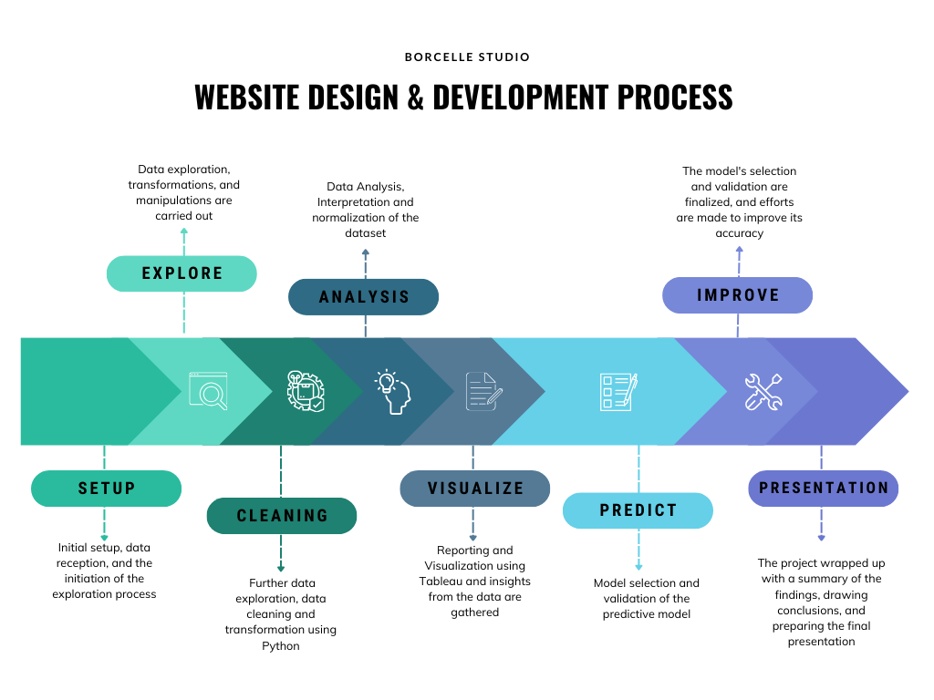
Project Objectives
Develop a Predictive model to forecast vehicle counts using data from Microwave Vehicle Detection systems for traffic analysis.
Goal : Predict segment MVD volume with > 95% accuracy

Slide 5

Data Collection and Exploration
Data Source: 4-year data has been received in the form of CSV.
Extract: Data from a CSV file containing details from 19 MVDs.
Transform: Added the missing minutes for the entire year 2023. Setting missing values to zero for volume and speed.
Load: Analyze the extended dataset to understand vehicle trends and seasonality.
Tools Used
Alteryx – To clean
Tableau – For visualization
Python – Jupyter, VSCode
Python Libraries (pandas, prophet, matplotlib, pandasprofiling)
SMU HPC – for computing needs

Slide 6
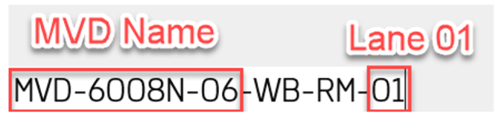
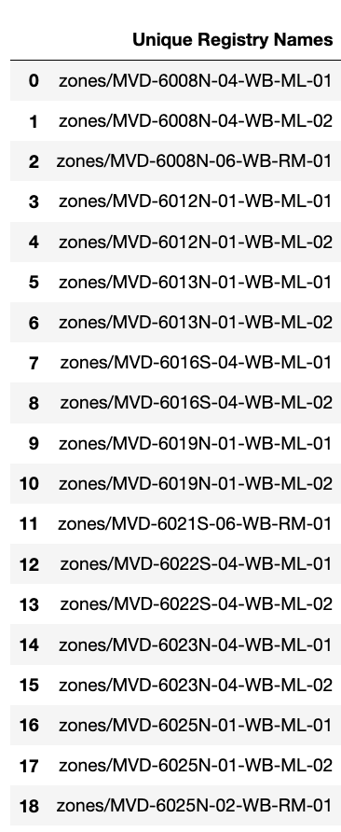
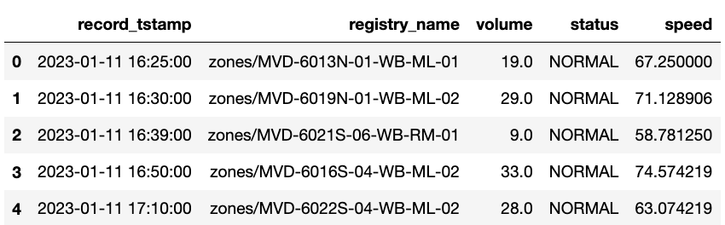
MVD – Microwave Vehicle Detection
High-definition radar sensors capture vehicle counts, speeds, lane occupancy, classifications, and 85th percentile speeds every minute per lane, yielding over a million daily records on LBJ, NTE, and 35W.
Data Columns:
record_tstamp: Timestamps each entry in CST for chronological analysis.
registry_name: Enumerates 11 unique MVDs across 19 registry names for lane-specific data collection.
volume: Measures minute-wise average traffic volume by lane.
status: Reflects MVD's operational condition as "NORMAL" or "COMM FAIL."
speed: Captures average vehicle speed minute-by-minute for traffic pace analysis.
MVD List:
11 Unique MVDs based on MVD Name
19 Unique ‘registry_name’
(All the managed lane MVD will generate 2 lanes volume without shoulder volume and all the ramp MVD will generate 1 lane volume)

Slide 7
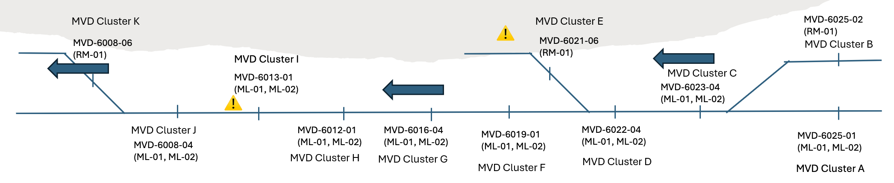
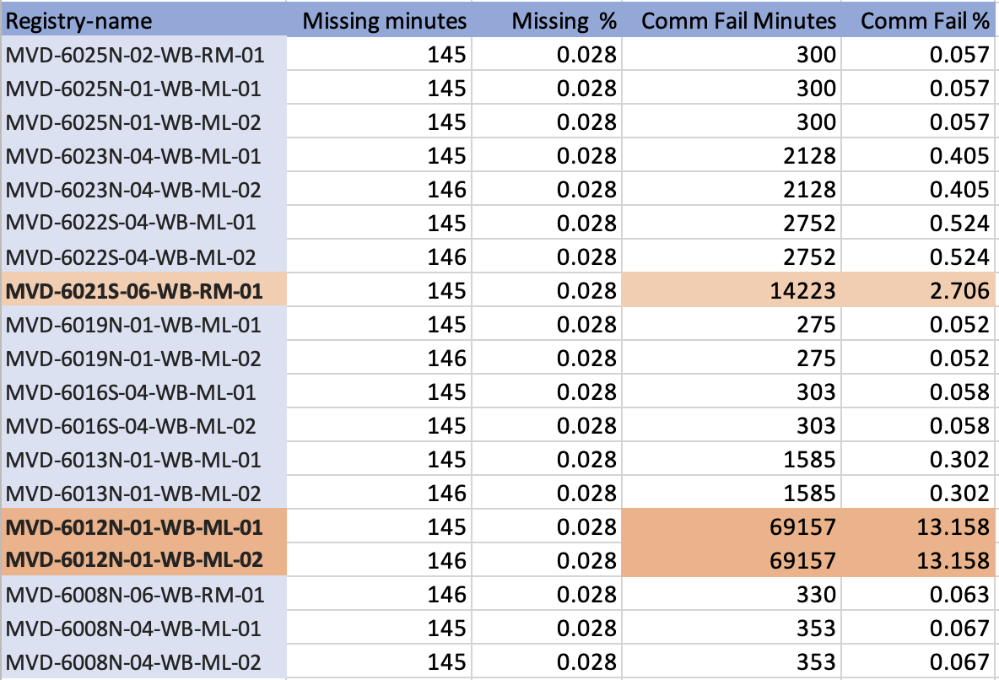
Problematic MVDs
⚠️
Problematic MVDs due to missing minutes or communication failure​​​​
MVDs with "UNKNOWN" status or missing minutes = 146 min​​
"COMMFAIL"​​​
MVD-6012N-01-WB-ML-02 ​​​​
MVD-6012N-01-WB-ML-01 ​​​
Number of minutes of COMMFAIL = 69157 which is definitely accountable. ​​​
Missing minutes - July 14 – July 31 and August 1 - August 30​​​ in 2023
MVD-6021S-06-WB-RM-01​​​
Number of minutes of COMMFAIL = 14223 ​​​
Missing minutes - January 1 - January 9​
OFFSET A = MVD Cluster C – (MVD Cluster A + MVD Cluster B)

Slide 8
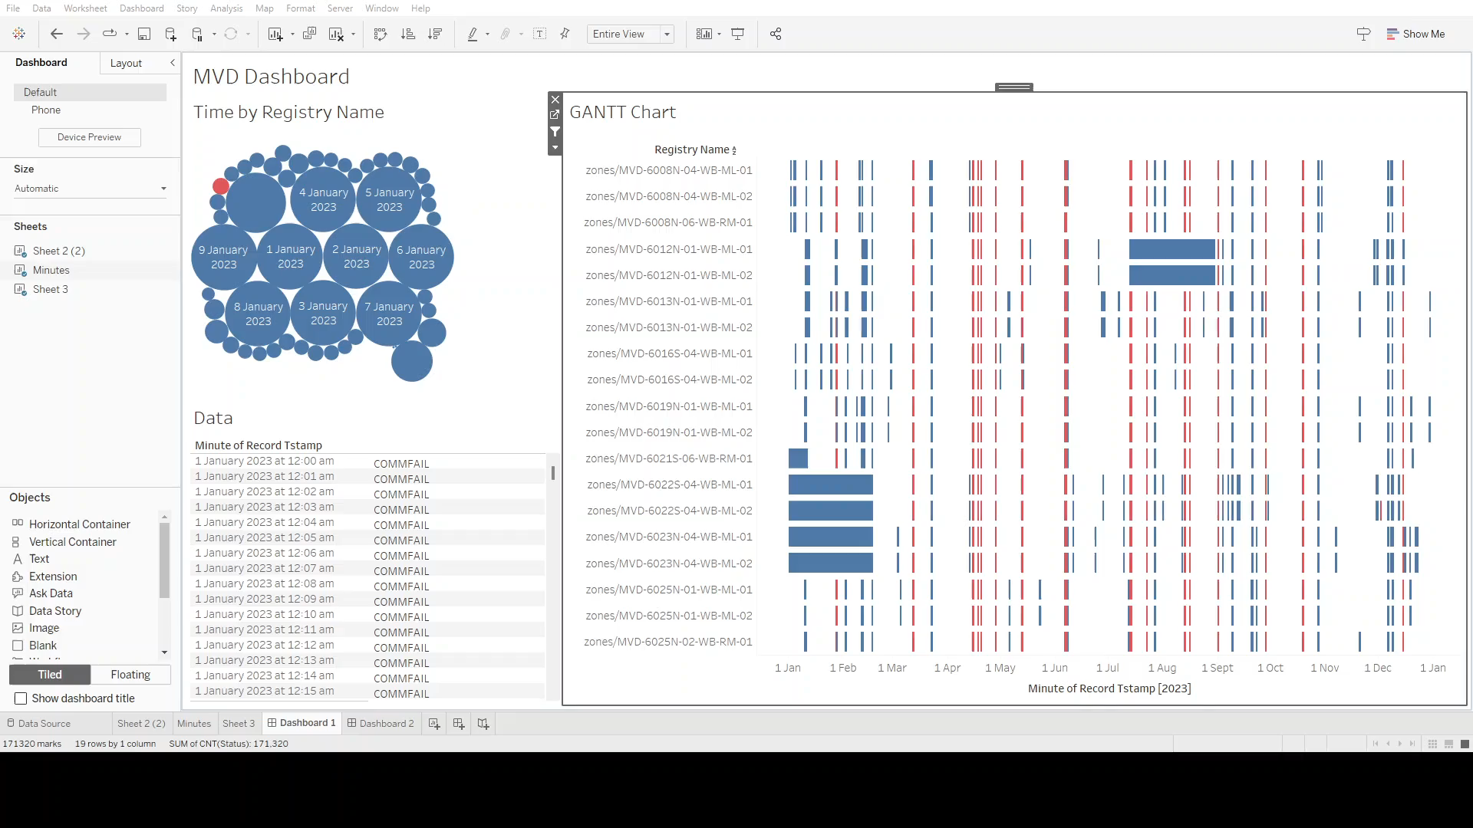
MVD Segment 2 Roadmap - Insights from Tableau

Slide 9
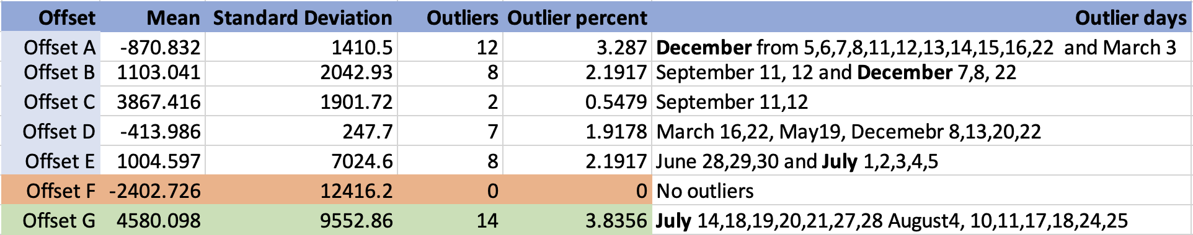
Offset Calculation
⚠️
OFFSET A = MVD Cluster C – (MVD Cluster A + MVD Cluster B)

Slide 10
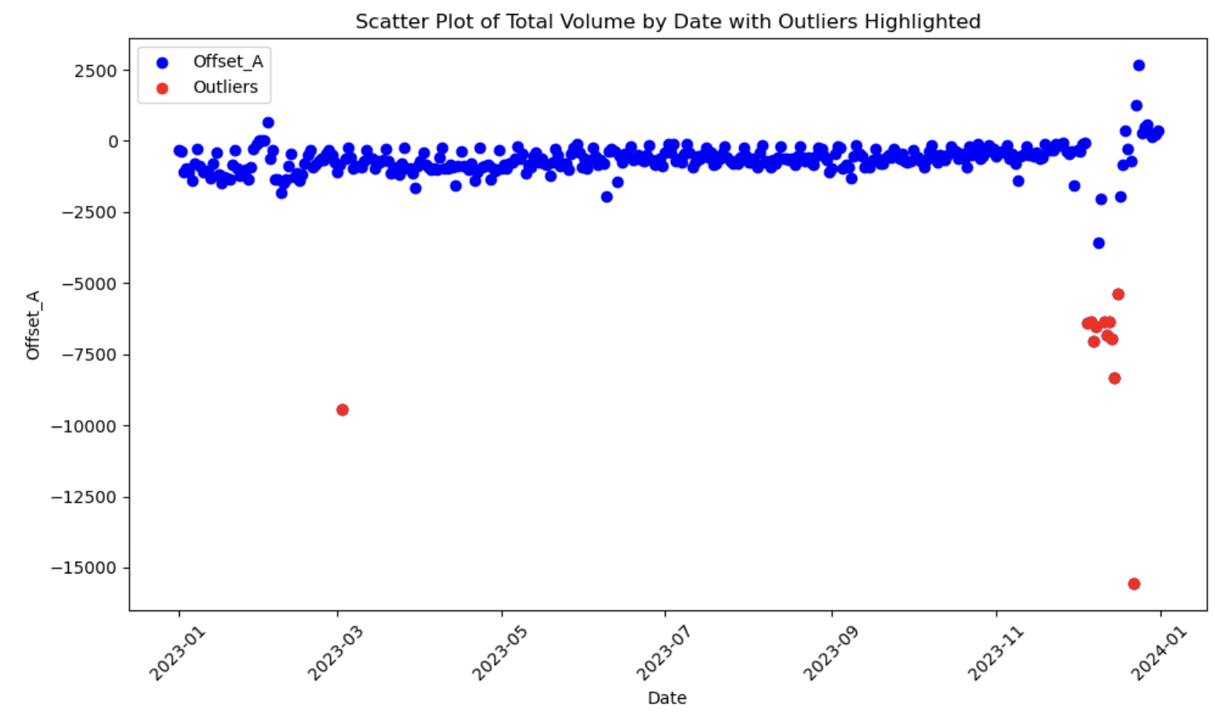
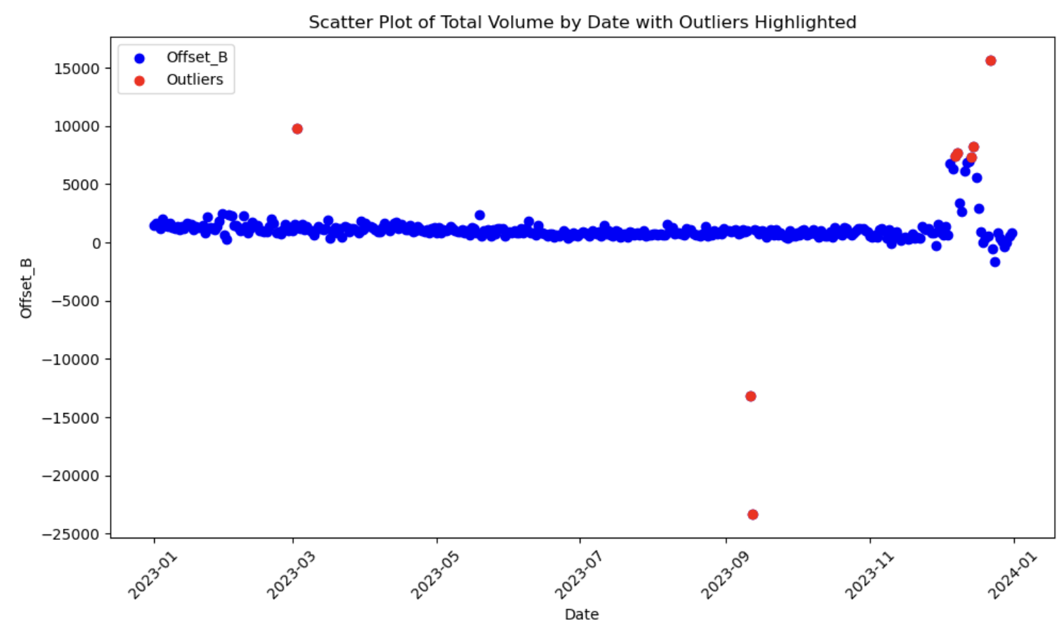
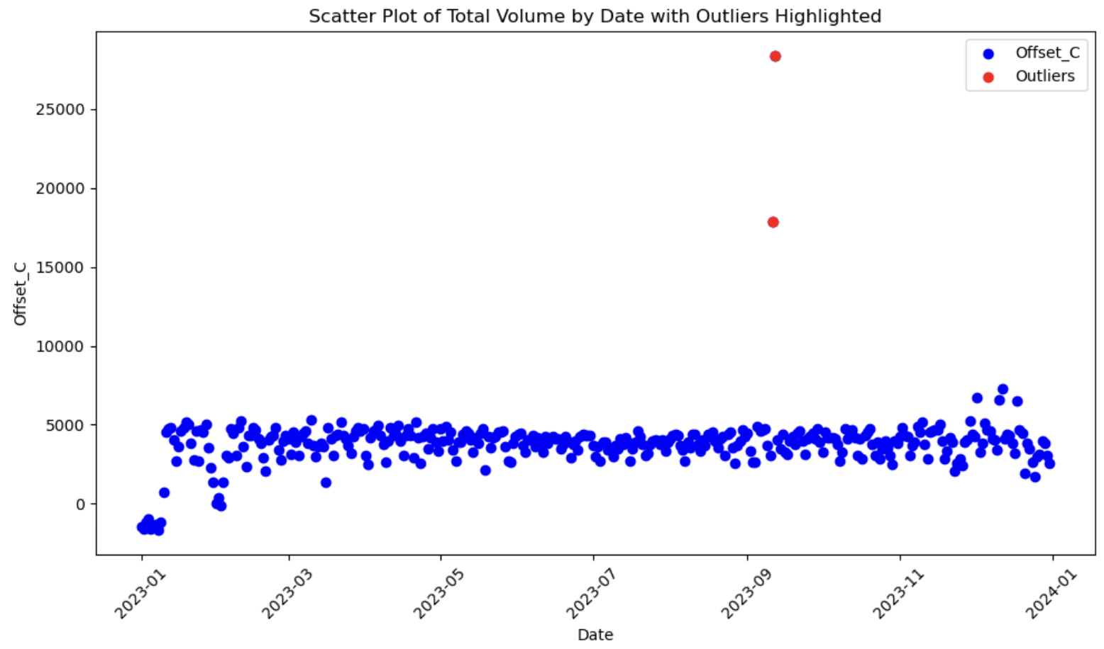
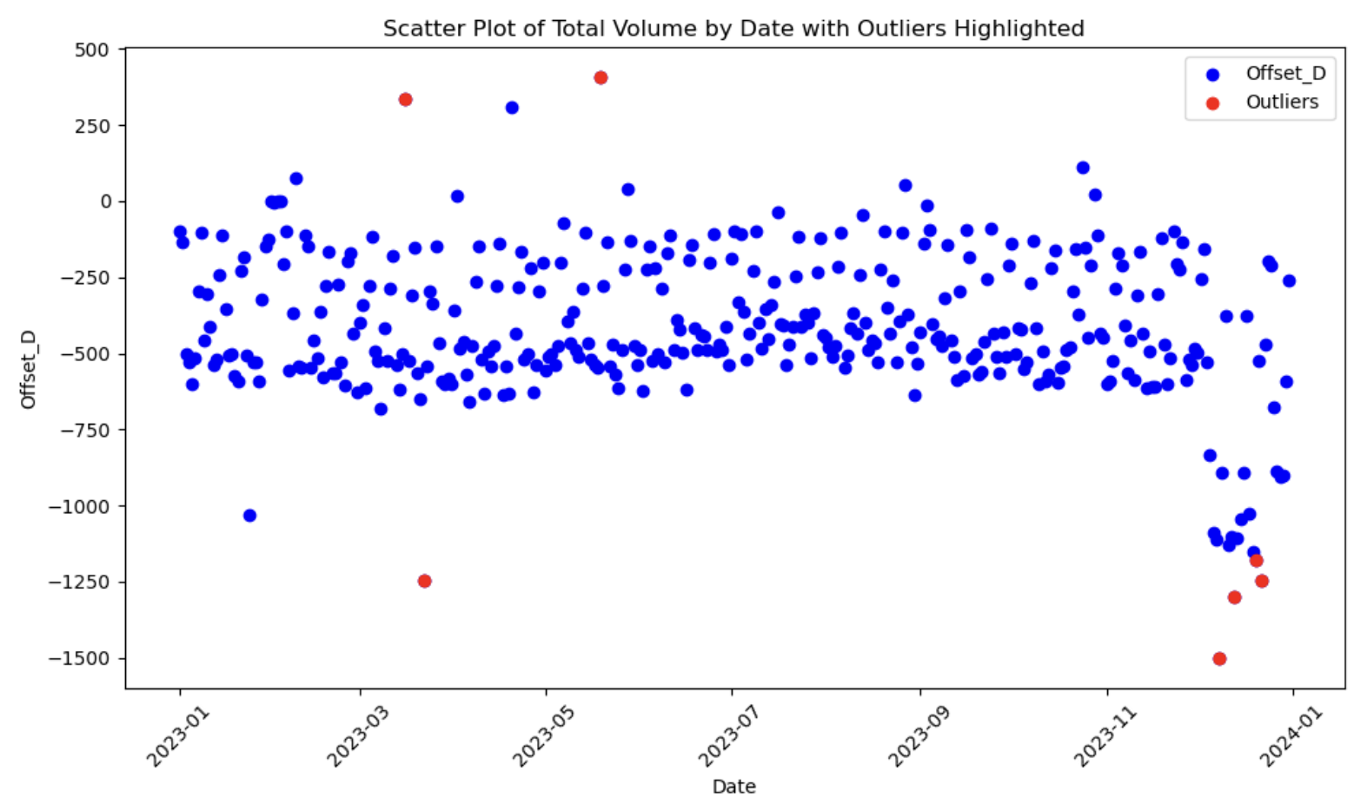
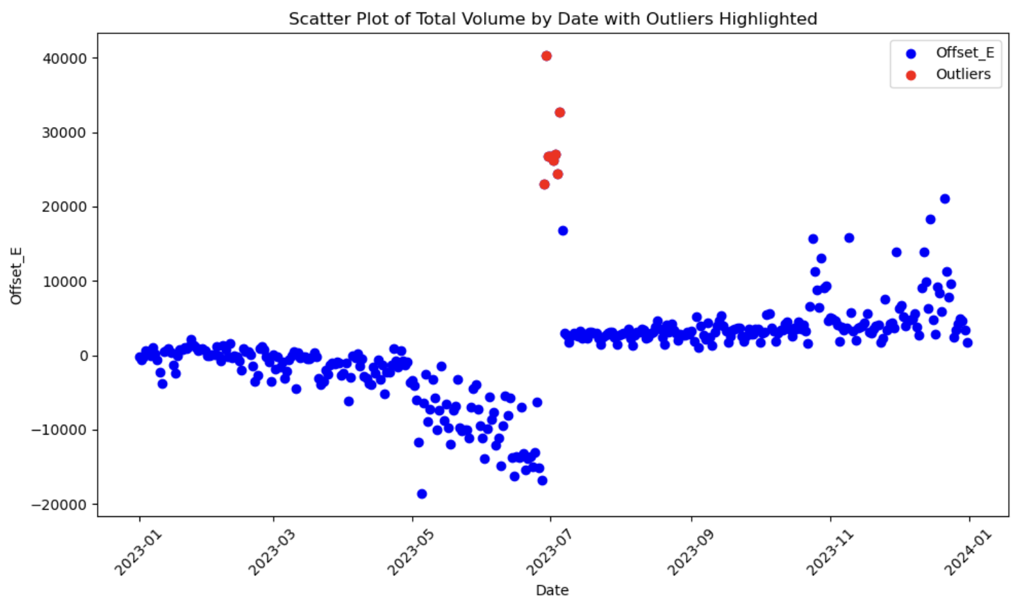
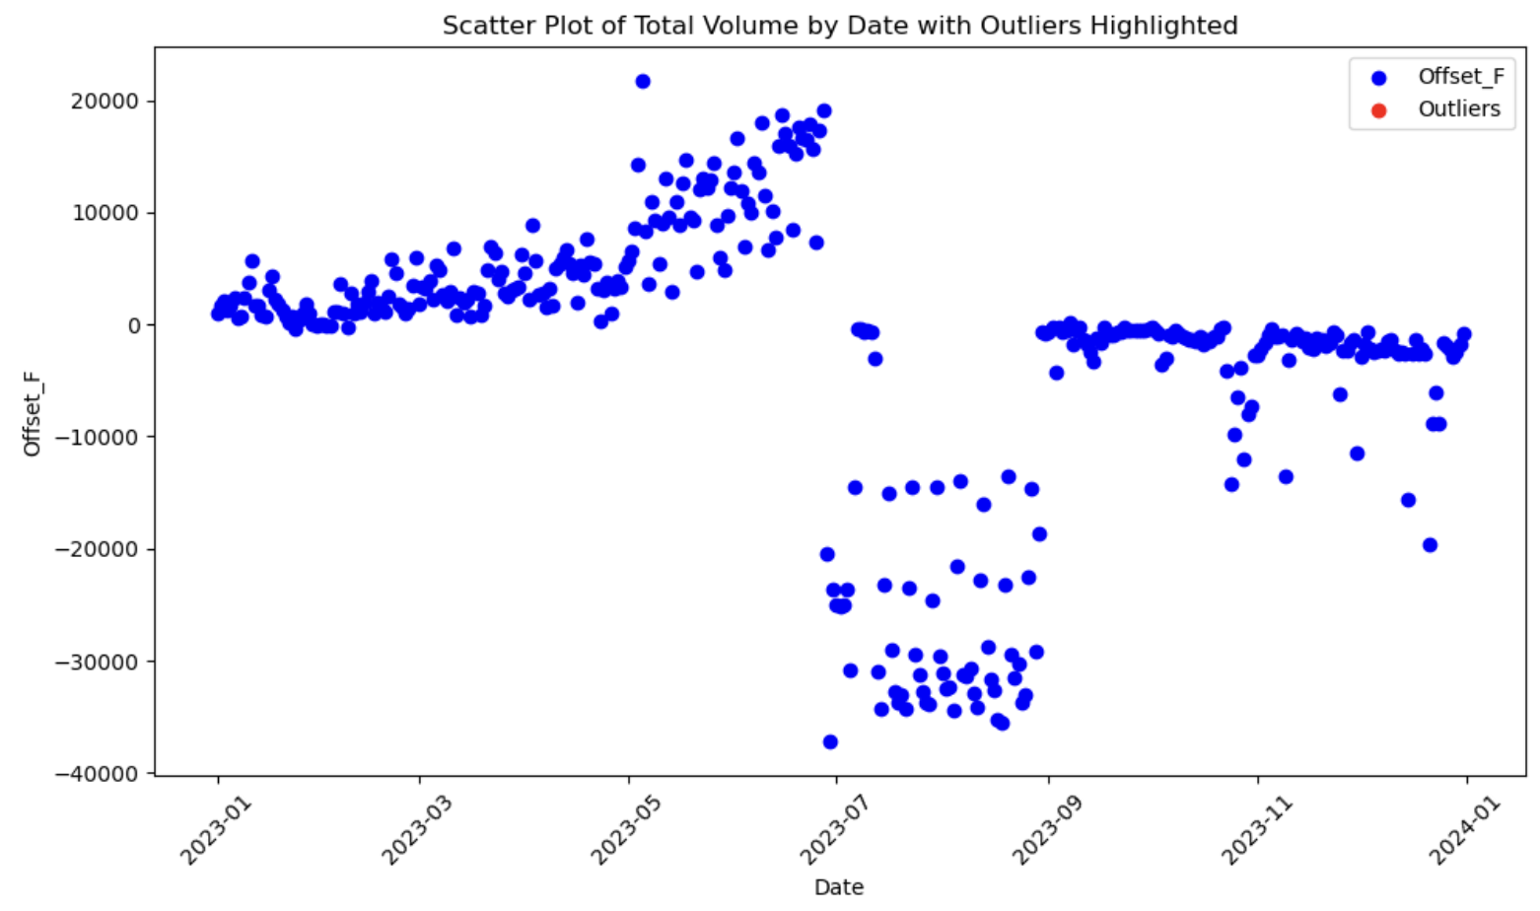
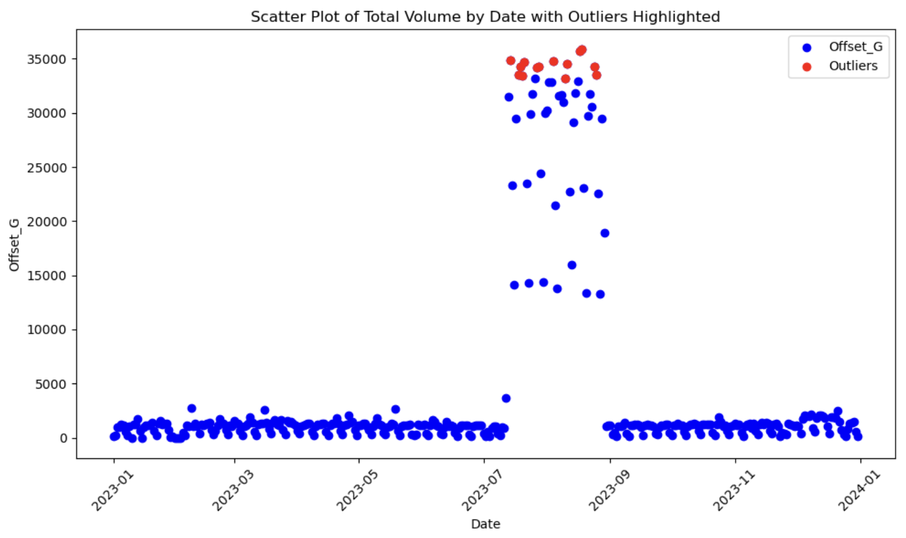
Scatterplot of outliers based on daily offset
Offset A Mean: -870.832
St Dev: 1410.507%
Outliers: 3.287%
Offset B Mean: 1103.041 St Dev: 2042.93
% Outliers: 2.191%​
Offset C​ Mean: 3867.416
St Dev: 1901.72
% Outliers: 0.547%​
Offset D Mean: -413.986
St Dev: 247.7
% Outliers: 1.917%​
Offset F has 0 Outliers due to missing minutes in 6012 MVD and also it has high SD
Offset G has highest Outliers
Red dots represent the outliers
Offset E Mean: 1004.597
St Dev: 7024.6​​ % Outliers: 2.191%​
Offset F​ Mean: -2402.726
St Dev: 12416.2
% Outliers: 0%​
Offset G Mean: 4580.098
St Dev: 9552.86
% Outliers: 3.835%​

Slide 11
Forecasting Model
Prophet forecasting Model
How does it compare to others.?
Prophet is user-friendly, excels in handling complex seasonal patterns, and adapts to trend changes, making it ideal for forecasting tasks that involve irregular data, including missing values and outliers.
Model implementation and forecast results
Prediction accuracy – achieved predicting ~ 95% accuracy segment MVD volume with RMSE of 4.81
Holidays: Distort regular traffic trends, impacting prediction precision.
Data Gaps: Sensor outages or malfunctions necessitate imputation methods to maintain prediction accuracy.
Variable Traffic Conditions: Unforeseen incidents disrupt normal flow, necessitating external data for enhanced predictive reliability.

Slide 12
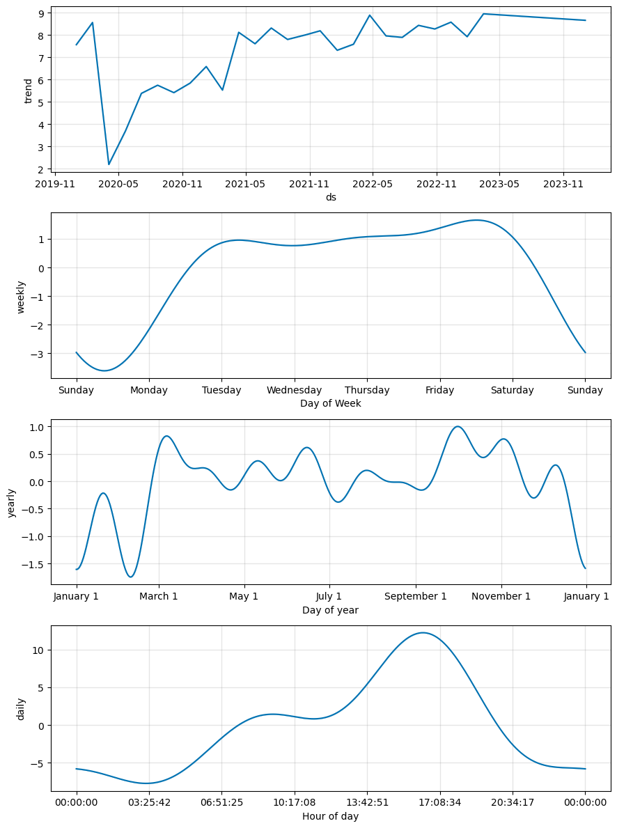
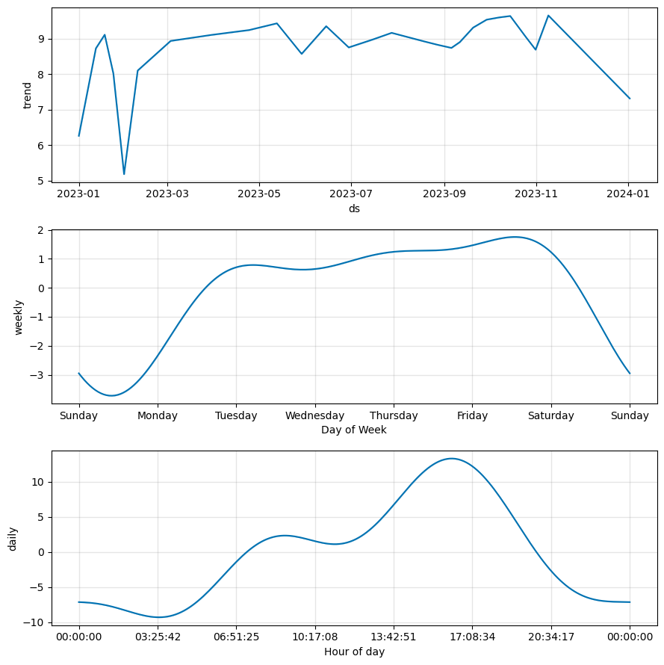
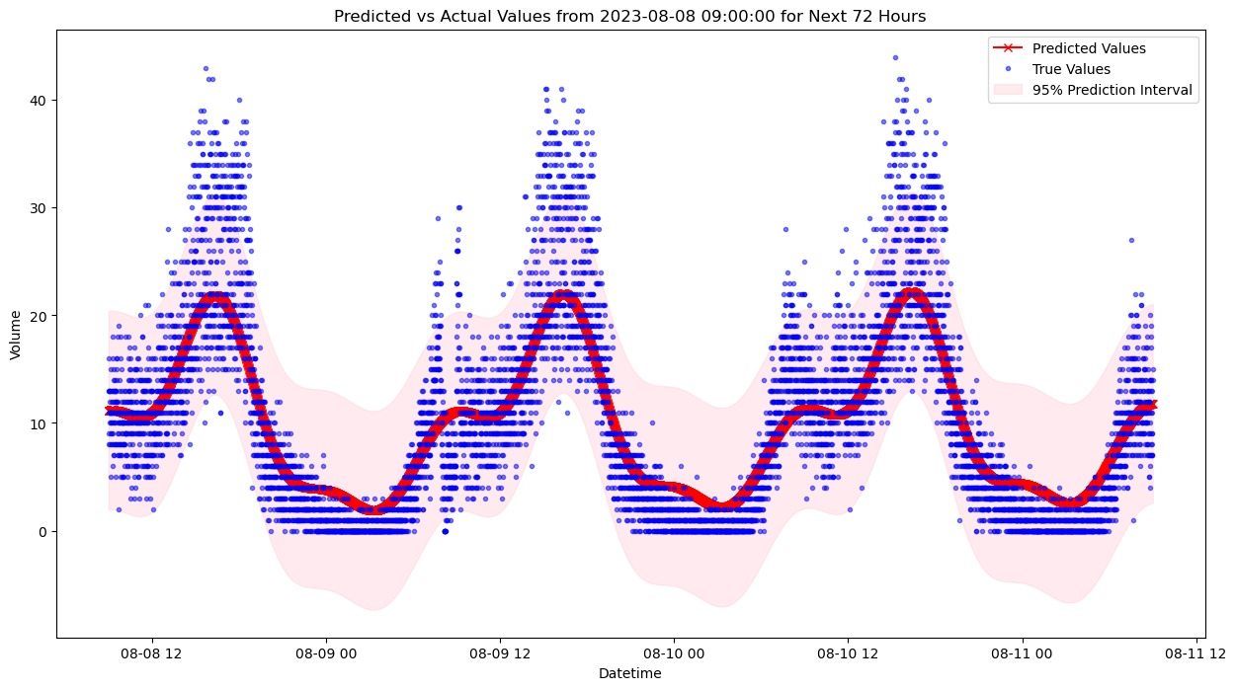
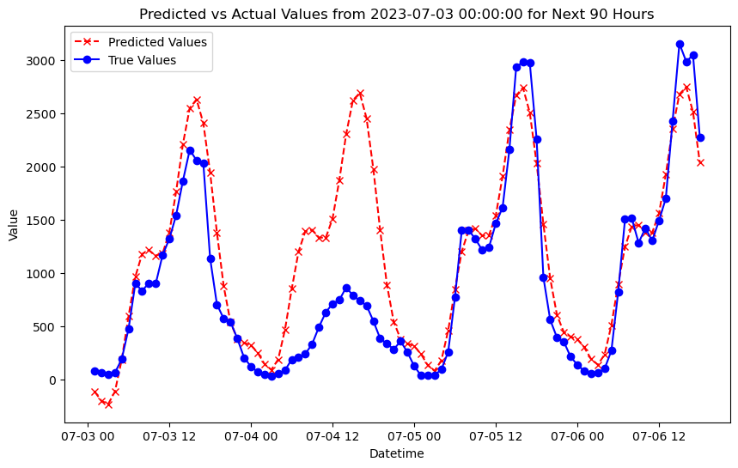
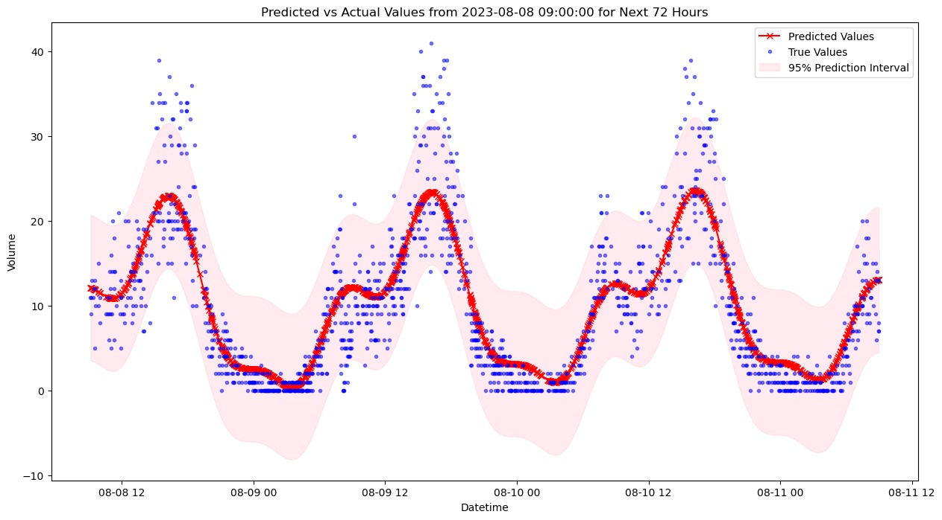
Trend Analysis and Prediction Analysis
Prediction Components for the Model that’s trained on the 4 Year data
Prediction Components for the Model that’s trained on 1 Year data
Volume by the Timestamps (4-year)- Volume trend during the COVID is lowest.
Volume by the Timestamps (Year 2023)
Trend by the Day of the Week – Peaks on Friday Nights, Lowest on a Sunday Night
Trend by the Day of the Week for the Year 2023
Trend by the Day of the Year – Less volume in Winter months
Trend by the Hour of the day – Captures the peaks and is adjusted to the higher volume of the data in 2023
Trend by the Hour of the day – Peaks at 9AM and 5PM
The 4-year model is better at recognizing the trend in the yearly seasonality like holidays
Blue Dots – Actual Data
Red Line – Prediction of the Model
The 1-year model more accurately captures rush hour peaks with fewer errors compared to the 4-year model, though shock by a holiday is not anticipated

Slide 13
Recommendations
Enhancing Offset Calculations with Distance: By integrating data on the distances between MVD's we could improve the model’s capacity for offset calculations. Addition of distance with some strategies like Geospatial weighting, Validation and testing might aim to unlock advanced analytical insights, leading to superior understanding of traffic dynamics.
Maintenance Recommendations: Maintenance should be prioritized on MVDs with high 'COMMFAIL' counts as these indicate communication failures. For instance, Cluster H and F show a significantly higher number of COMMFAILS compared to others. They should be inspected first, and some strategies can be infused like maintenance scheduling ,technical diagnostics, reporting and documentation to ensure robust performance and longevity in MVD systems.
Enhancing Time Series Forecasting: Augmenting volume data with key factors for a comprehensive forecasting model like Including weather conditions, holiday effects, and anomaly events to capture external influences on trends which gives more accurate prediction model that reflects complex real-world dynamics.
Selecting a Deep-Learning Model: We've chosen the Prophet model because when Compared to more intricate options like LSTM models that demand computing power and fine-tuning, With the external factors, a deep learning model can predict the volume count with higher accuracy and lower error

Slide 14

Questions ?

Slide 15
Appendix
Python Notebook
Data profiling
Offset Calculation Document

